Slide 1

Search Engines and their Algorithms Rhodes College
C. Lee Giles
David Reese Professor, College of Information Sciences and Technology
Graduate Professor of Computer Science and Engineering
Courtesy Professor of Supply Chain and Information Systems
The Pennsylvania State University, University Park, PA, USA
giles@ist.psu.edu
http://clgiles.ist.psu.edu
https://en.wikipedia.org/wiki/Lee_Giles

Slide 2
Search Engines
How They Work and Why You Should Care
For search engines, it’s algorithms everywhere you look
(or all the way down)

Slide 3
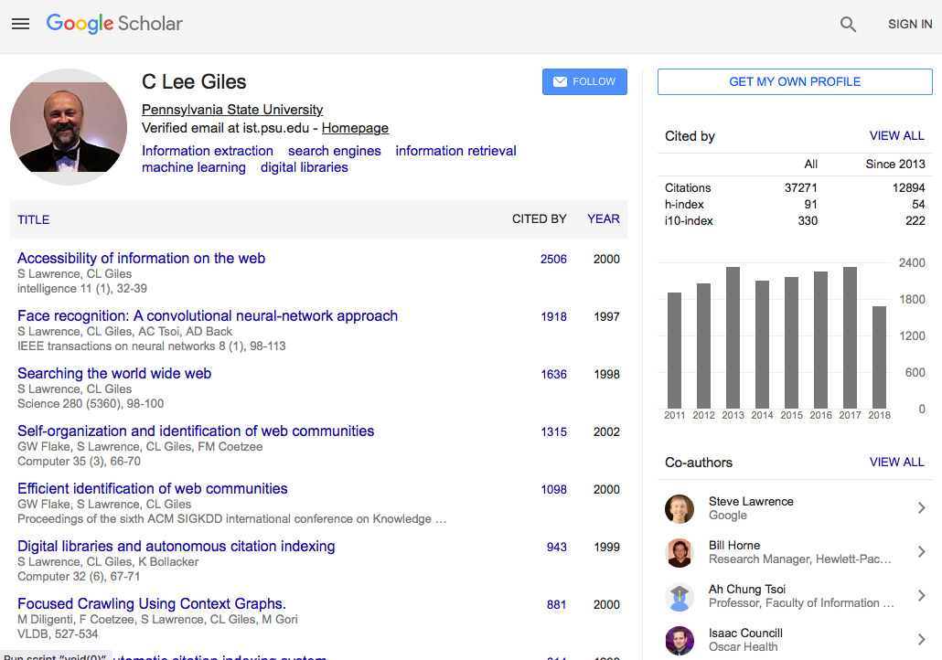

Slide 4
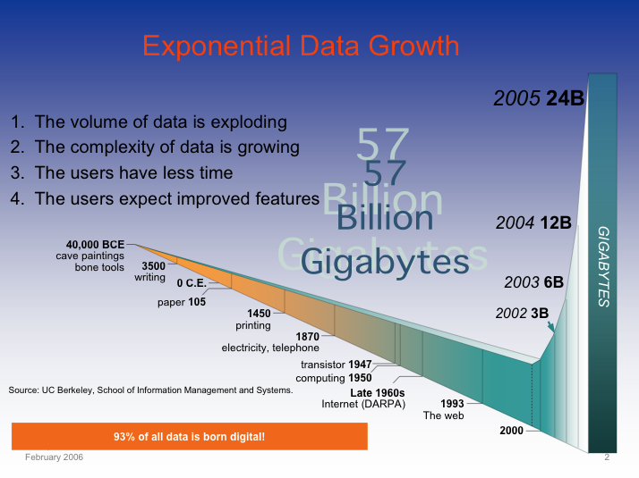
Digitization of Everything: the Zettabytes are here
Soon most everything will be recorded and indexed
Much will remain local
Most bytes will never be seen by humans.
Search, data summarization, trend detection, information and knowledge extraction and discovery are key technologies
So will be infrastructure to manage this.

Slide 5
Search Engine Basics
What we search – usually the World Wide Web (WWW)
Search engines
Types
Business models
Representation
Text - vectors
Ranking
Text similarity
Link analysis (graph search)
Google
THE dominant search engine

Slide 6
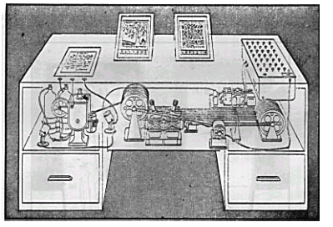
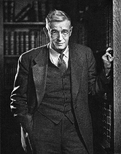
Vannevar Bush - Memex - 1945
Early ideas of search engines
"A memex is a device in which an individual stores all his books, records, and communications, and which is mechanized so that it may be consulted with exceeding speed and flexibility. It is an enlarged intimate supplement to his memory.”
Bush seems to understand that computers won’t just store information as a product; they will transform the process people follow to produce and use information.

Slide 7
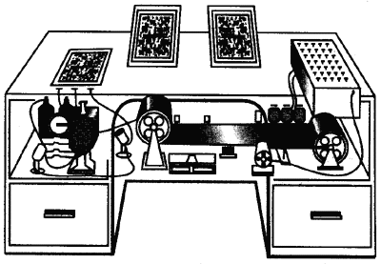
Bush 1945 – As We May Think
The memex is a desktop
machine, consisting of:
A user interface.
A repository of documents.
A search engine.
A linking mechanism.
Memex II can learn from its experience.

Slide 8
Quotes from As We May Think
“The human mind … operates by association. With one item in its grasp, it snaps instantly to the next that is suggested by the association of thoughts, in accordance with some intricate web of trails carried by the cells of the brain. … trails that are not frequently followed are prone to fade …. Yet the speed of action, the intricacy of trails, … is awe-inspiring beyond all else in nature.”
“A memex is a device in which an individual stores all his books, records, and communications, and which is mechanized so that it may be consulted with exceeding speed and flexibility. It is an enlarged intimate supplement to his memory.”
“There is a new profession of trail blazers, those who find delight in the task of establishing useful trails through the enormous mass of the common record.”
Notes:
Read this quote if there is time.

Slide 9
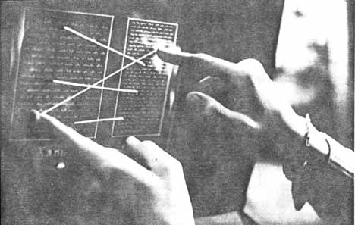
Nelson’s Hypertext
A universal hypertext.
Xanadu is a distributed network of documents (1960’s).
User interface - transpointing windows.
Elaborate copyright mechansim.
Superceded by WWW

Slide 10
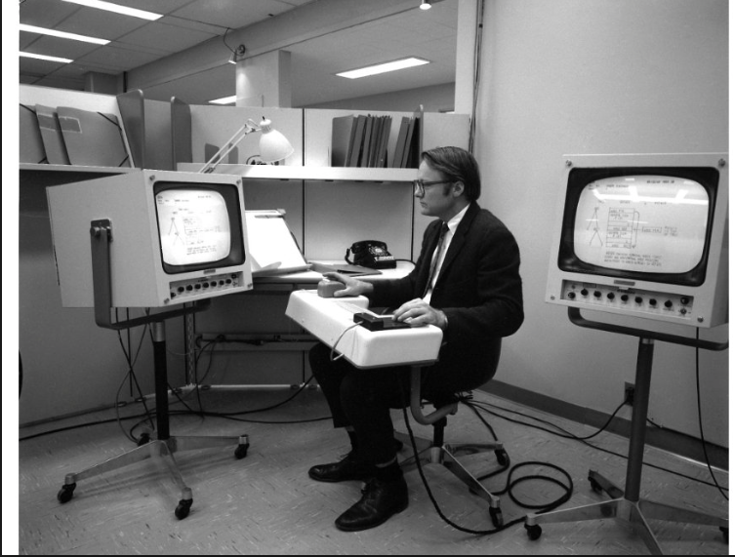
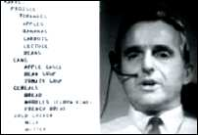
Engelbart’s oNLine System (1968)
First working hypertext system, where documents were linked together (funded by DARPA).

Slide 11
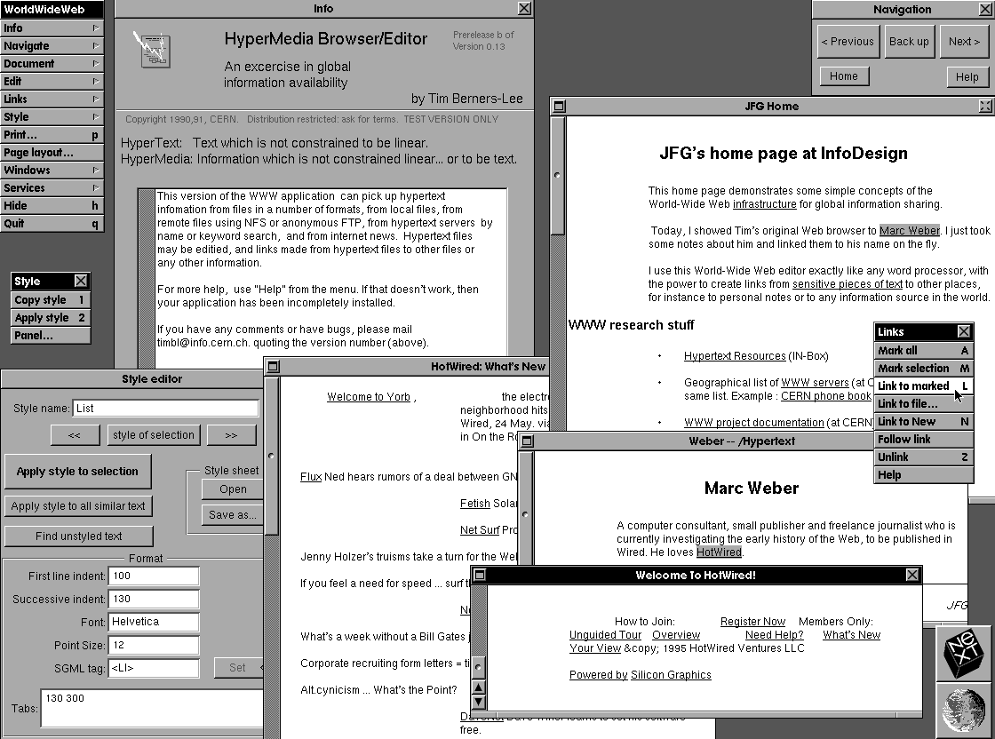
Tim Berners-Lee’s WWW
CERN 1990 - First Browser
Web protocols & languages
URL
HTTP
HTML
World Wide Web Consortium (W3C) founded in 1994

Slide 12
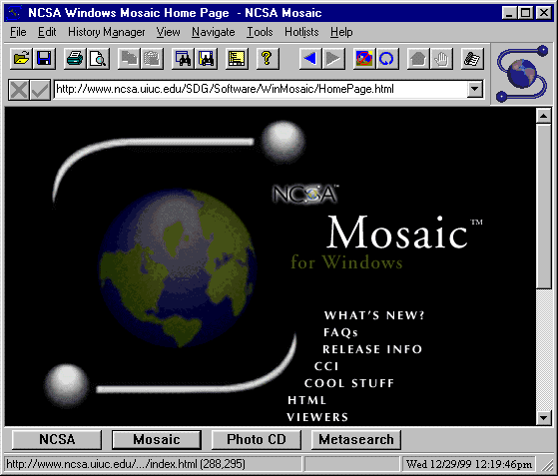

Mosaic – The Web Browser that changed history
Released late 1993 – developed by Marc Andreessen
Netscape triggered the boom of WWW throughout the 90’s
Browser wars with Microsoft – IE won (2003 stats: 95.6% - IE, 3.7% NS)
Chrome now dominates
What browsers do you use?

Slide 13
Difference between the internet and the web
Internet – physical computer network infrastructure on which the web is built.
The World Wide Web (web) is a virtual network defined through the web protocols.
The internet supports other protocols such as email, ftp and instant messaging.

Slide 14
Math/data structures/algorithms used in search engines
Little theory:
lots of heuristics in computer and information science
Math:
Set theory
Vector and matrix models
Similarity measures
Indexing – no databases
Graphs
Ranking
Scaling – Big O – users, documents
Code: Linux – C, C++, Python, Java

Slide 15
Measuring the Growth or Cost of Work or Hardness of a Problem – Big O
While it is possible to measure the work done by an algorithm for a given set of inputs, we need a way to:
Measure the rate of growth of an algorithm based upon the size of the input (or output)
users, documents, hardware
Compare algorithms to determine which is better for the situation
Compare and analyze for large problems
Examples of large problems?

Slide 16
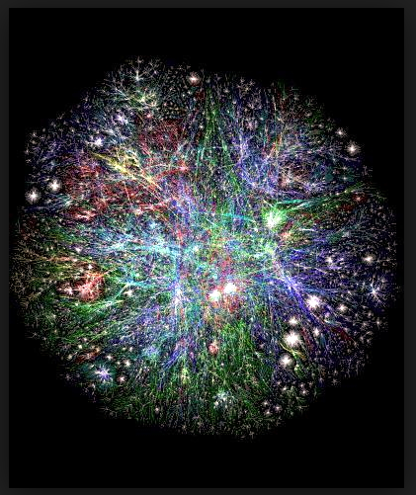
3D Web

Slide 17
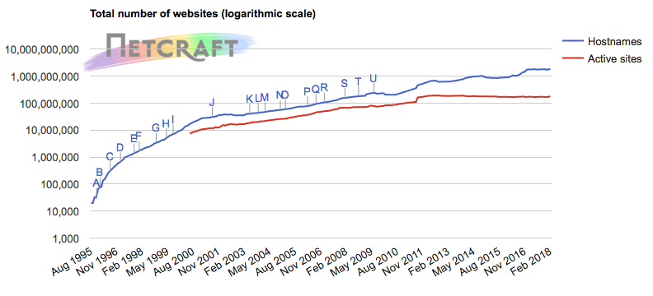
Netcraft Web Server Survey http://news.netcraft.com/archives/web_server_survey.html

Slide 18
Web Search
Goal
Provide information discovery for large amounts of open access material on the web
Challenges
• Volume of material -- several billion items, growing steadily
• Items created dynamically or in databases
• Great variety -- length, formats, quality control, purpose, etc.
• Inexperience of users -- range of needs
• Economic models to pay for the service

Slide 19
Search Engine Strategies
Types of search engines
Broad Classes:
Web crawling + automatic indexing
• General -- Google, Bing, Exalead, Baidu, Yandex
Subject hierarchies
• Yahoo! , dmoz -- use of human indexing
Mixed models
• Graphs - KartOO; clusters – Clusty (now Yippy)
Metasearch
New ones evolving - mobile

Slide 20
Many Aspects of a Web Search Service
Computational Components
• Web crawler
• Indexing system
• Search system
Social Considerations
• Economics
• Scalability
• Legal issues

Slide 21
Query Engine
Index
Interface
Indexer
Users
Crawler
Ranking by web graph
Web
A Typical Web Search Engine

Slide 22
What is a Web Crawler?
Also called: spider, bot, harvester
The Web crawler is a foundational species!
Without crawlers, search engines would not exist.
But they get little credit!
How they are controlled
Robots.txt

Slide 23
Robots Exclusion Protocol
Site administrator puts a “robots.txt” file at the root of the host’s web directory.
http://www.ebay.com/robots.txt
http://www.cnn.com/robots.txt
http://clgiles.ist.psu.edu/robots.txt
http://en.wikipedia.org/robots.txt
File is a list of excluded directories for a given robot (user-agent).
Exclude all robots from the entire site:
User-agent: *
Disallow: /
New Allow:
Find some interesting robots.txt

Slide 24
Business Models
Subscription
Monthly fee with logon provides unlimited access (introduced by InfoSeek)
Advertising
Access is free, with display advertisements (introduced by Lycos)
Can lead to distortion of results to suit advertisers
Focused advertising - Google, Overture
Licensing
Cost of company are covered by fees, licensing of software and specialized services
Others?

Slide 25
Business models for advertisers Search engine optimization (SEO)
For a related query such as “tennis shoes”
Does your company
Comes up first in SERP (search engine results page)
Comes up on the first SERP page
Otherwise, say goodbye to web business
Completely dependent on search engines ranking algorithm for organic SEO
Google changes ranking
Will other search engines follow?

Slide 26
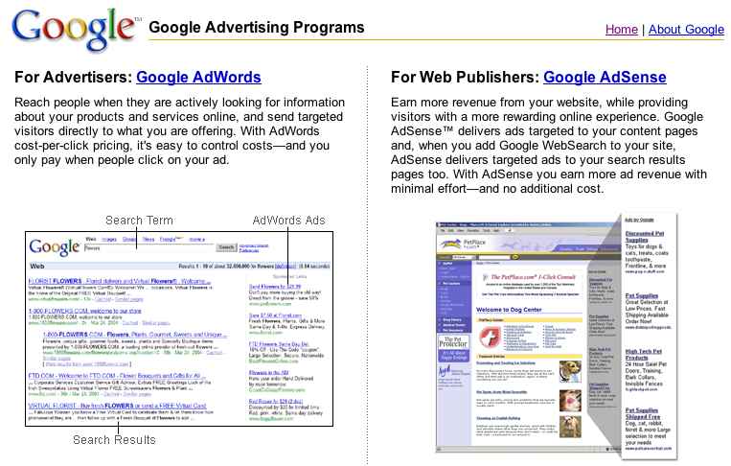

Slide 27
Generations of search engines
0th - Library catalog
Based on human created metadata
1st - Altavista
First large comprehensive database
Word based index and ranking
2nd - Google
High relevance
Link (connectivity) based importance

Slide 28
Query Engine
Index
Pre-indexing
Interface
Indexer
Text processing
(preprocessing)
Users
Crawler
Web
A Typical Web Search Engine

Slide 29
Search Engine Evaluation Relevant vs. Retrieved Documents
Use set models
All docs
Retrieved
Relevant

Slide 30
Precision vs. Recall
All docs
Retrieved
Relevant

Slide 31
Retrieved vs. Relevant Documents
Very high precision, very low recall
retrieved
Relevant

Slide 32
Retrieved vs. Relevant Documents
High recall, but low precision
Relevant
retrieved

Slide 33
Retrieved vs. Relevant Documents
Very low precision, very low recall (0 for both)
retrieved
Relevant

Slide 34
Retrieved vs. Relevant Documents
High precision, high recall (at last!)
retrieved
Relevant

Slide 35
Bag of words view of a document
Tokens are extracted from text and thrown into a “bag” without order and labeled by document.
Thus the doc
John is quicker than Mary.
is indistinguishable from the doc
Mary is quicker than John.
is
Mary
John
than
quicker

Slide 36
TERM VECTOR SPACE
Term vector space
n-dimensional space, where n is the number of different terms/tokens used to index a set of documents.
Vector
Document i, d_{i}, represented by a vector. Its magnitude in dimension j is w_{ij}, where:
w_{ij} > 0 if term j occurs in document i
w_{ij} = 0 otherwise
w_{ij} is the weight of term j in document i.

Slide 37
Vector model of text Bag of words model
document text terms
d₁ ant ant bee ant bee
d₂ dog bee dog hog dog ant dog ant bee dog hog
d₃ cat gnu dog eel fox cat dog eel fox gnu
ant bee cat dog eel fox gnu hog length
d₁ 2 1 √5
d₂ 1 1 4 1 √19
d₃ 1 1 1 1 1 √5
Weights: t_{ij} = frequency that term j occurs in document i

Slide 38
Basic Vector Space Methods: Similarity between 2 documents
t₃
The similarity between two documents is a function of the angle between their vectors in the term vector space.
d₁
d₂
θ
t₂
t₁

Slide 39
Document similarity (Vector Space Scoring)
d = (w₁, w₂,w₃, ..., w_{n}) is a vector in an n-dimensional vector space
Length of d is given by (extension of Pythagoras's theorem)
|d|² = w₁² + w₂² + w₃² + ... + w_{n}²
|d| = (w₁² + w₂² + w₃² + ... + w_{n}² )^{1/2}
If d₁ and d₂ are document vectors:
Inner product (or dot product) is given by
d₁.d₂ = w₁₁w₂₁ + w₁₂w₂₂ + w₁₃w₂₃ + ... + w_{1n}w_{2n}
Cosine angle between the docs d₁ and d₂ determines doc similarity
cos (θ) =
d₁.d₂ |d₁| |d₂|
cos (θ) = 1; documents exactly the same; = 0, totally different

Slide 40
Data structure for search – inverted index
Documents are parsed one document at a time to extract tokens/terms. These are saved with the Document ID (DID) to create a postings file.
<term, DID>
Doc 1
Doc 2
Now is the time
for all good men
to come to the aid
of their country.
It was a dark and
stormy night in
the country
manor. The time
was past midnight.

Slide 41
How Inverted Files are Created
After all documents have been parsed, the inverted file is sorted alphabetically and in document order.
Each entry is a posting

Slide 42
Inverted index with term counts
Multiple term/token entries for a single document are merged.
Within-document term frequency information is compiled.
Result: list of postings
<term,DID,tf>
<the,1,2>

Slide 43
Can algorithms make money or start a company?
Google – PageRank search algorithm
Worth ~ $500 billion
Many are searching for new ranking algorithms

Slide 44
PageRank in Words
Intuition:
Imagine a web surfer doing a simple random walk on the entire web for an infinite number of steps.
Occasionally, the surfer will get bored and instead of following a link pointing outward from the current page will jump to another random page.
At some point, the percentage of time spent at each page will converge to a fixed value.
This value is known as the PageRank of the page.

Slide 45
PageRank
Link-analysis method used by Google (Brin & Page, 1998).
Does not attempt to capture the distinction between hubs and authorities.
Ranks pages just by authority.
Query independent
Applied to the entire web rather than a local neighborhood of pages surrounding the results of a query.

Slide 46
The Web of documents
Sec. 19.2
No design/co-ordination
Distributed content creation, linking, democratization of publishing
Content includes truth, lies, obsolete information, contradictions …
Unstructured (text, html, …), semi-structured (XML, annotated photos), structured (Databases)…
Scale much larger than previous text collections … but corporate records are catching up
Growth – slowed down from initial “volume doubling every few months” but still expanding
Content can be dynamically generated
The Web

Slide 47
PageRank Algorithm
Let S be the total set of pages.
Let ∀p∈S: E(p) = α/|S| (for some 0<α<1, e.g. 0.15)
Initialize ∀p∈S: R(p) = 1/|S|
Until ranks do not change (much) (convergence)
For each p∈S:
For each p∈S: R(p) = cR´(p) (normalize)
New algorithms to replace PageRank are being explored!

Slide 48
PageRank Idea
Just measuring in-degree (citation count) doesn’t account for the authority of the source of a link.
Initial page rank equation for page p:
N_{q} is the total number of out-links from page q.
A page, q, “gives” an equal fraction of its authority to all the pages it points to (e.g. p).
c is a normalizing constant set so that the rank of all pages always sums to 1.

Slide 49
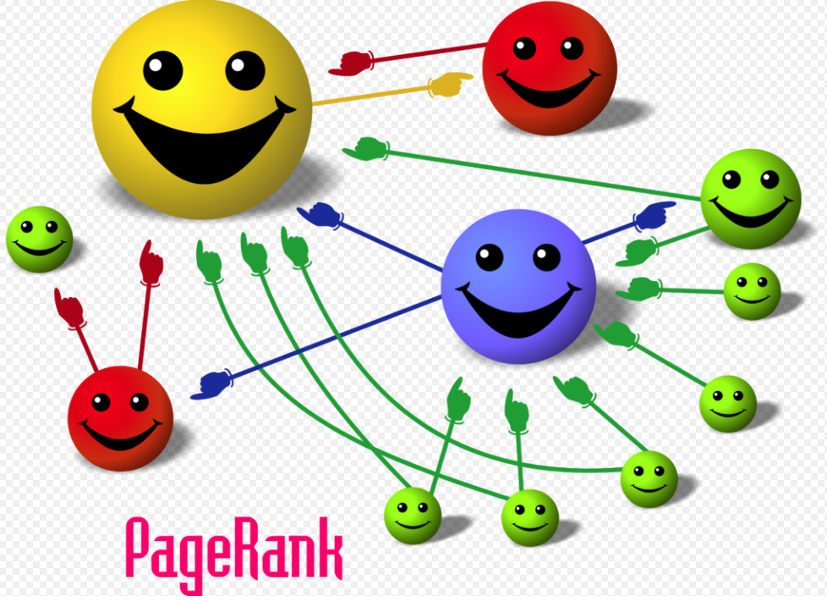
3D Web

Slide 50
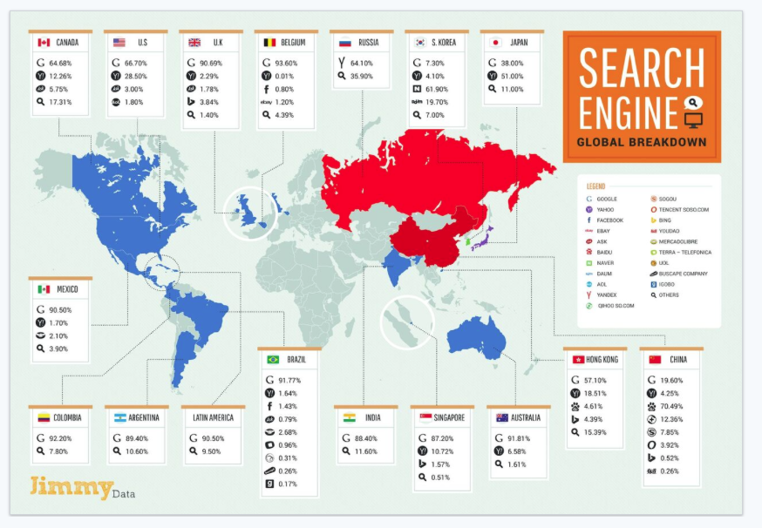
Multiplatform Usage 2016
Effect of PageRank – Google Rules

Slide 51
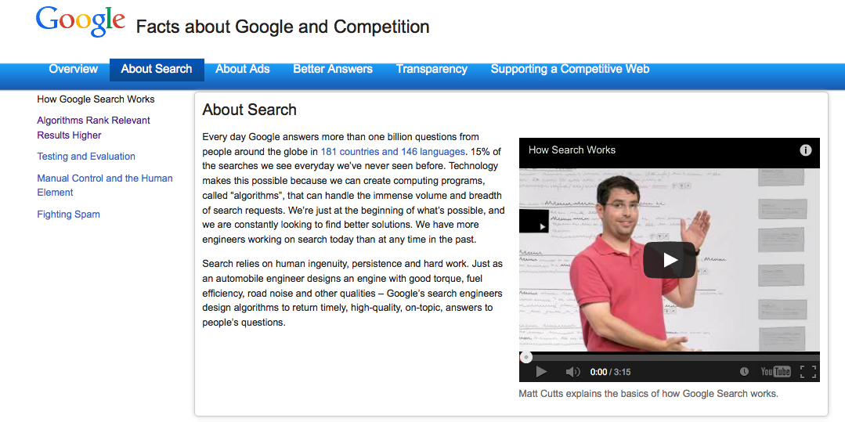
Google Facts

Slide 52
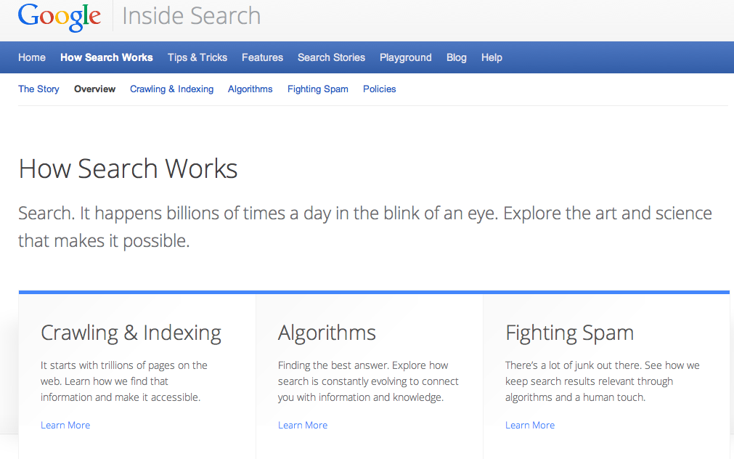
Google search

Slide 53
Types of Search Queries - Broder
A taxonomy of web searches (out of date)
In the web context the "need behind the query" is often not informational in nature.
Navigational. 25%
The immediate intent is to reach a particular site.
Informational. 40%
The intent is to acquire some information assumed to be present on one or more web pages.
Transactional. 35%
The intent is to perform some web-mediated activity.

Slide 54
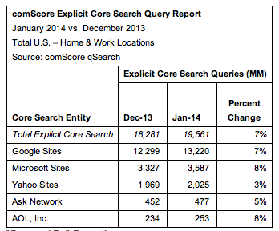
Number of search engine queries - US
About half a billion per day
ComScore global share

Slide 55
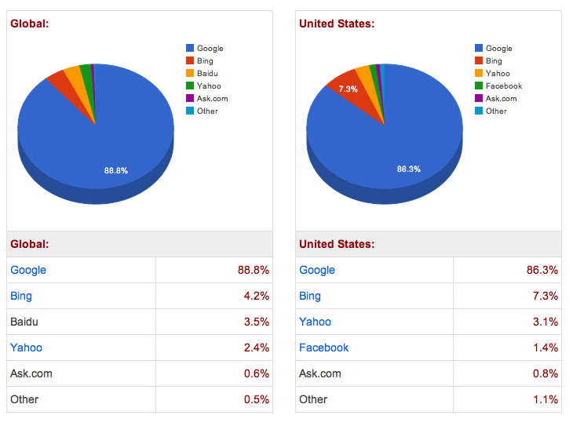
Dec 2012
2 billion internet users

Slide 56
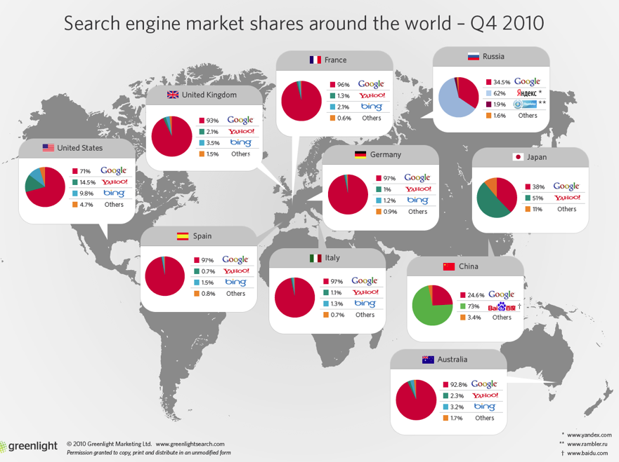

Slide 57
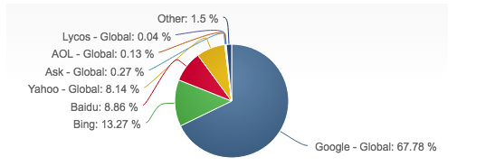
March 2016 – Net Share Market

Slide 58
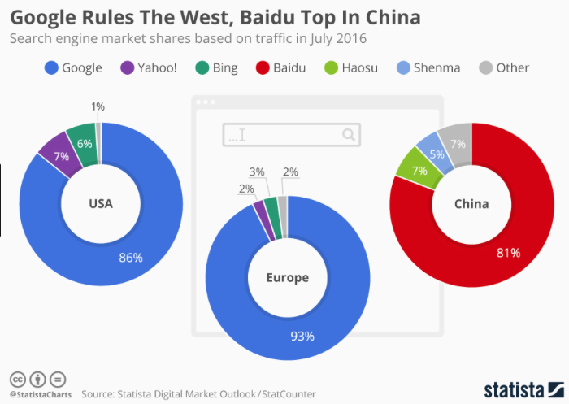
2017

Slide 59
2012

Slide 60
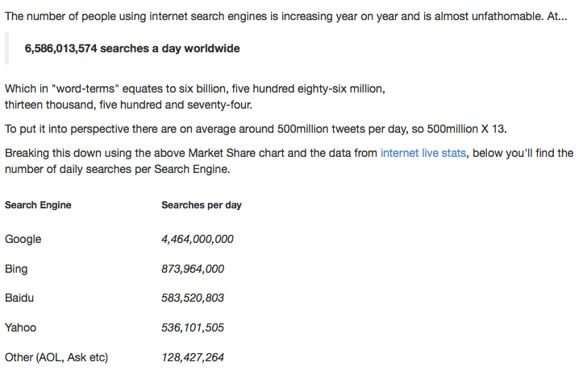
March 2016 – Net Share Market
Trillions a year

Slide 61
Are Google rankings fair? Are any search engines rankings fair?
Try out certain queries
about “jews”
“tiananmen square”
Google.com
Google.cn
Baidu.com

Slide 62
Breaking Google with queries
Odd queries:
Who doesn’t like me
How far …
Will a sponge ball crash through a glass table

Slide 63
What is role of search engines in society
Should these queries be banned?
“how do I make a dirty bomb”
“how do I make a black hole”
Do search engines have a social responsibility?

Slide 64
Social implications of public search engines
What is the web role of search in society
Human flesh search engine
What is the responsibility of search engines?
The googlization of everything
Should governments control search engines
Positions
Search is too important to be left to the private sector
Search will only work from 8 to 5 on weekdays and will be off on holidays and government shutdowns.
New Chinese government search engine
Panguso

Slide 65
Which search engine to use?
General queries
Google
Bing
Specialty (vertical) search engines for special search
Amazon
eBay
Semantic Scholar, CiteSeerX
Language dependent
Yandex, Baidu, … except Latin alphabet languages

Slide 66
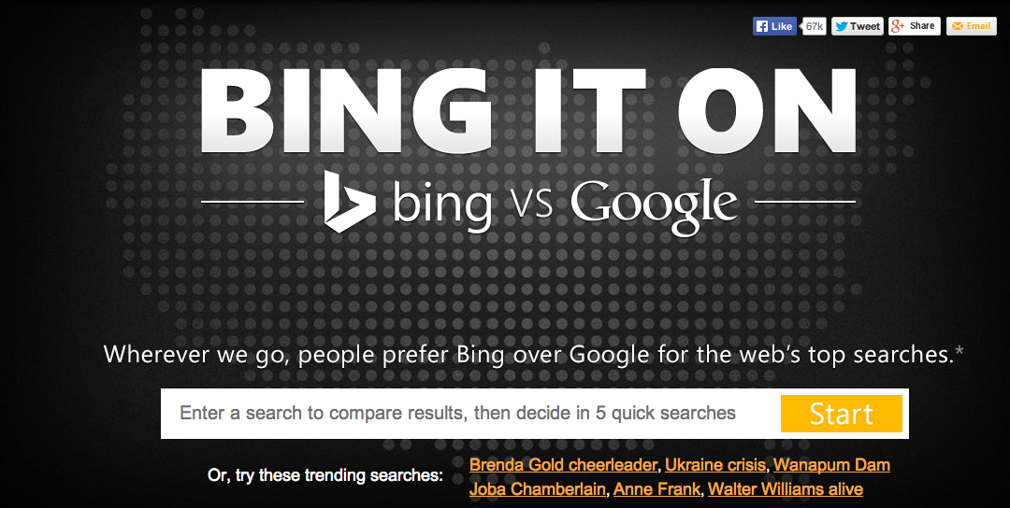
Google vs Bing

Slide 67
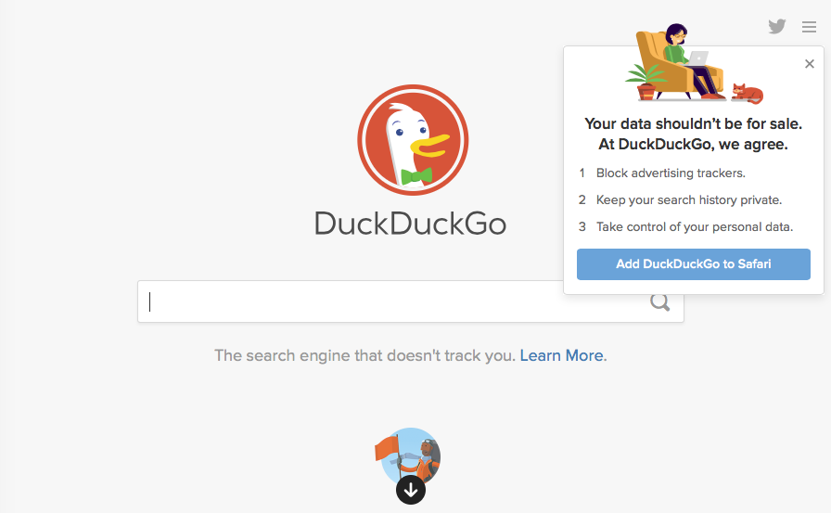
Privacy Search Engine

Slide 68
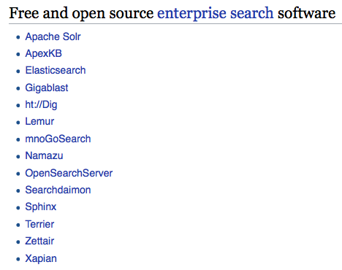
Open Source Search/Indexing Tools
Enterprise Search is Growing
Wikipedai-open-tools

Slide 69
Elastic/Lucene
Query Engine
Index
Interface
Users
Indexer
Crawler
Heritrix
Web
Web Search Engine with Open Source Parts

Slide 70
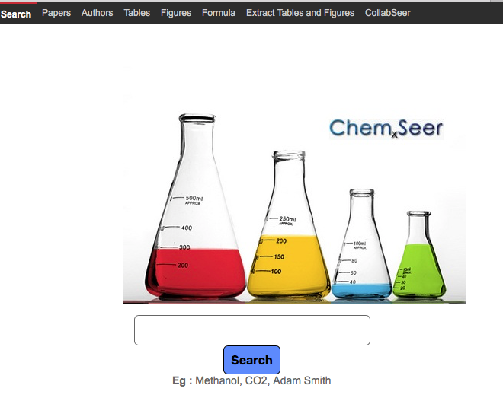
Google vs Bing

Slide 71
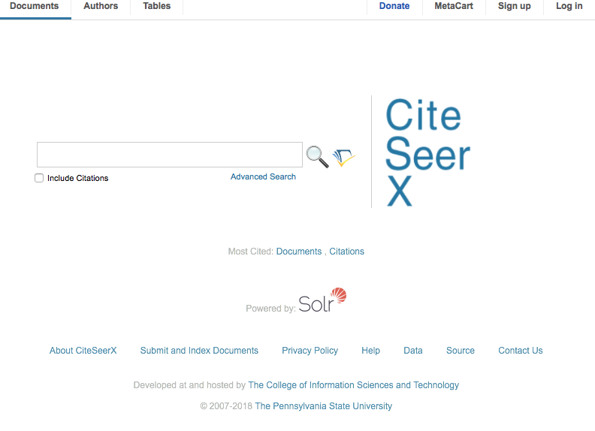
Google vs Bing

Slide 72

Future of Search: Semantic Web and Natural Language Processing Search
Do this by:
Somehow making data and metadata available on the Web in machine-understandable form (formalized) (Web 3.0)
Structure the data and meta-data in ontologies
Have Natural Language Processing Search Engines!
Google as an AI

Slide 73
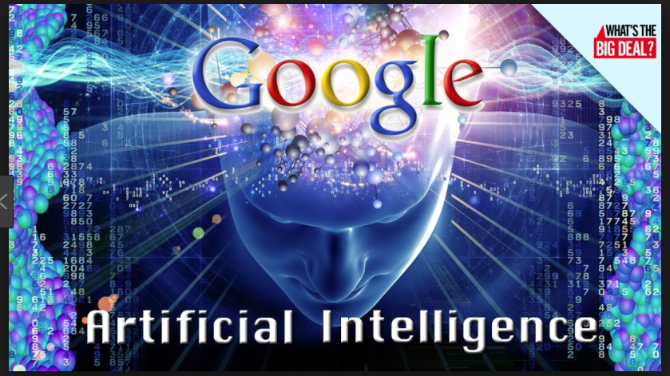
AI Google

Slide 74
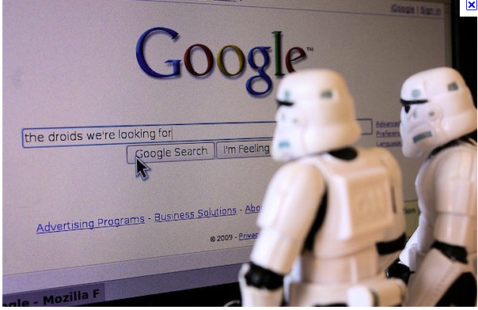
Google of the future

Slide 75
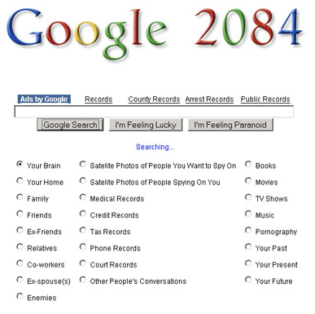
What next? GoogleFace or Faceoogle

Slide 76
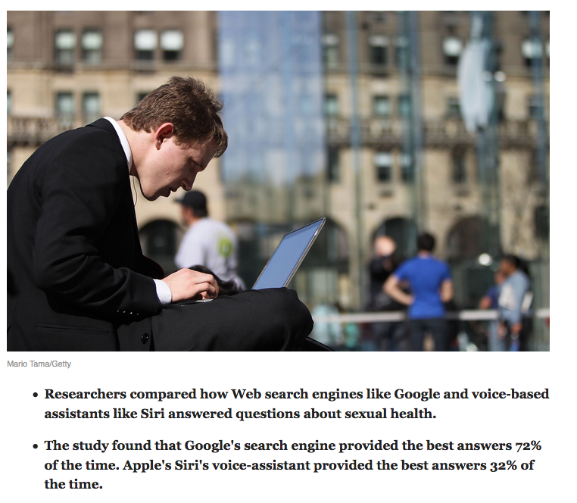
Do search engines still matter?

Slide 77
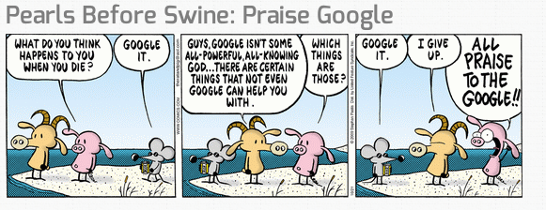

Slide 78
Search in the Future?
Enterprise search
Web gets smarter – Web 3.0
Search gets smarter - Natural language queries
Search agent (avatar) understands and anticipates your needs
Personal life search with avatar

Slide 79
What we covered
What search engines are
How they work
Who uses them
What next?

Slide 80
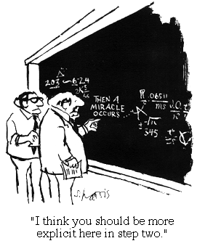
“The future ain’t what it used to be.” Yogi Berra, catcher/philosopher, NY Yankees.
For more information
Query “Lee Giles” in Google
http://clgiles.ist.psu.edu
giles@ist.psu.edu
gitbhub.com/SeerLabs

